Slide 1
Plan a Microsoft 365 Implementation
M365 – MS 100
Notes:
Importance planning

Slide 2

Plan a Microsoft 365 Deployment
Deployment Options
Subscription & License
Network Connectivity
Identity & Authentication
Tenant Management consideration
Identify Migration Consideration
Notes:
Picture

Slide 3
Deployment Options
Fast Track
Getting help from Microsoft to deploy M365
Microsoft Partner
Getting Help from Microsoft partners
Self deployment
Responsible to Plan and Deploy office 365

Slide 4
Subscription & License
M365 is a SaaS based cloud offering
Charge you per user per month
One month trial subscription available for M365
Users get access to cloud app based up on the license

Slide 5
Network Connectivity
M365 Cloud Apps are delivered over Internet
Security, Performance & Reliability depends upon the quality of internet connection.
Network evaluation need to performed
No of Users
Applications bandwidth requirement

Slide 6

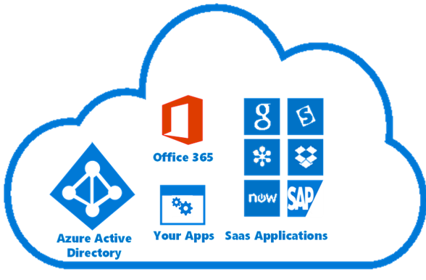



Plan your Identities
Corporate data center
Microsoft 365 Cloud
Active Directory
Users authenticate to Office 365 cloud Apps (Example: Exchange Online) via Azure AD.

Slide 7
Plan your Identities
Corporate data center
Microsoft 365 Cloud
Active Directory
Office 365 cannot connect to Local AD directly

Slide 8
Plan your Identities
Two Options

Slide 9
Plan your Identities
Corporate data center
Microsoft 365 Cloud
If all your apps and workloads are hosted on Azure and Microsoft 365, then you only need to authenticate against Azure AD

Slide 10


Plan your Identities
Corporate data center
Microsoft 365 Cloud
Active Directory
Users need to remember multiple passwords, one to access local workloads and another for Microsoft 365 applications

Slide 11
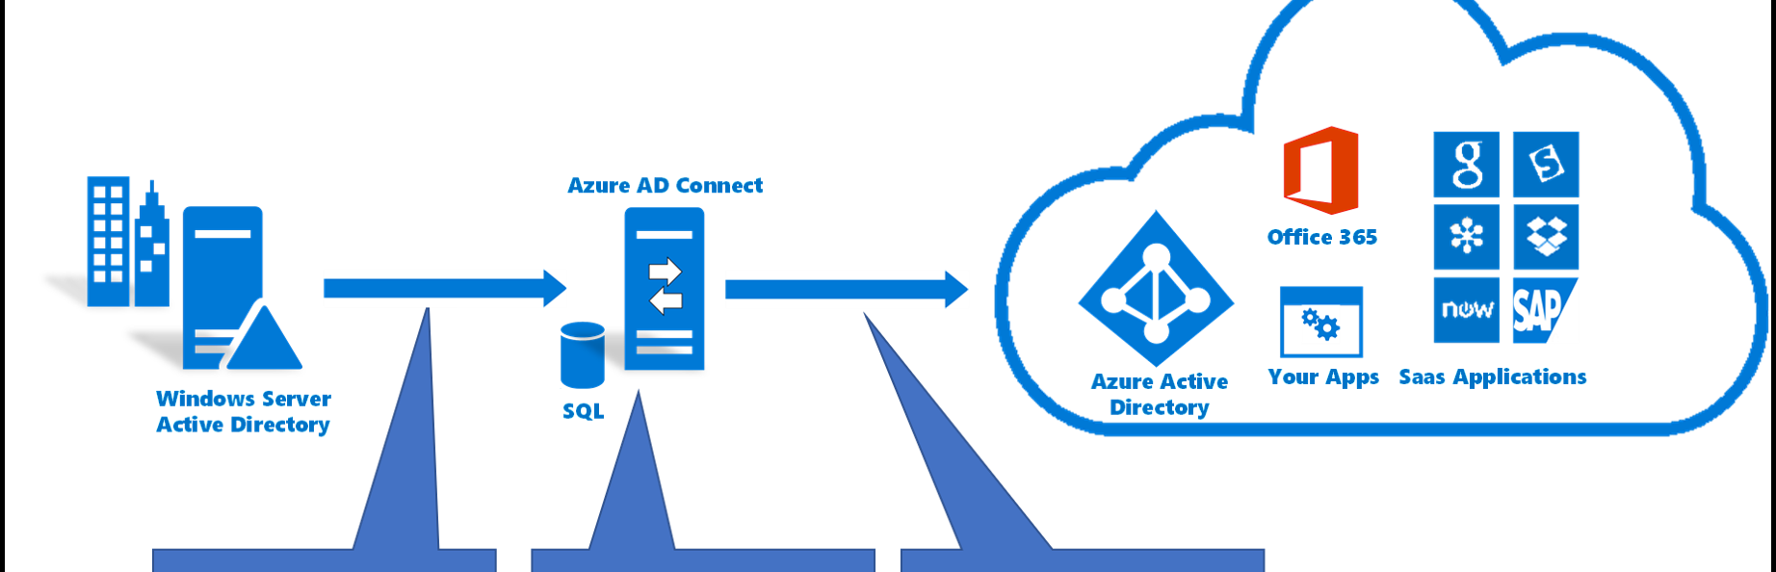
Hybrid Identity, create a copy of local identity in Azure AD for cloud Applications authentication.

Slide 12

Client Device and Cloud Authentication
Username and Password combination
Certificate based Authentication
Multifactor authentication

Slide 13

Tenancy Management Consideration
Identify Global Administrators
Exchange Server Administrator
SharePoint Administrator
Multiple Administrators

Slide 14
Identify Migration Consideration
Identity
Filter Users to be Migrated to Azure AD
Data
Identify the data need to migrated to Azure
Software
Software compatibility with new cloud apps

Slide 15
Next Video
Deployment Options
Subscription & License
Network Connectivity
Identity & Authentication
Tenant Management consideration
Migration Consideration
Summary
Microsoft Tenant & Subscription

